Slide 1
Racine County Economic Development & Land Use Planning Committee Public Hearing Meeting Monday, February 19, 2024 - 6:00 p.m. Ives Grove Office Complex Auditorium
Notes:
Notes:

Slide 2
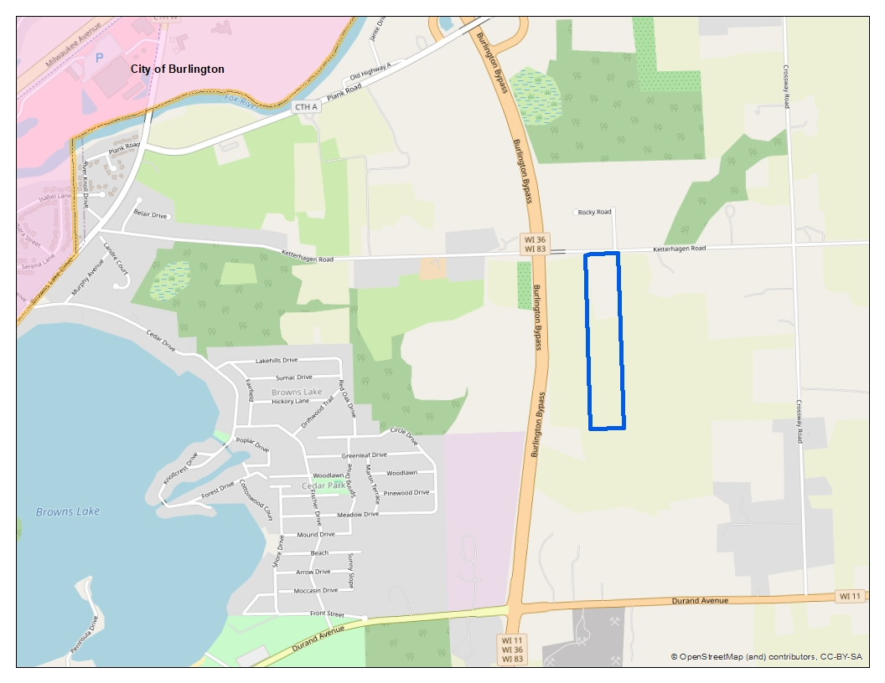
Kurt & Julie Petrie Living Trust, Owners
Site Address: west of 29019 Ketterhagen Road
Rezone from A-1 Farmland Preservation District & M-4 Quarrying District to A-2 General Farming & Residential District II
(Contains 29.88 acres)
Location Map
SEC 26 – T3N – R19E
Town of Burlington
Notes:
Notes:

Slide 3
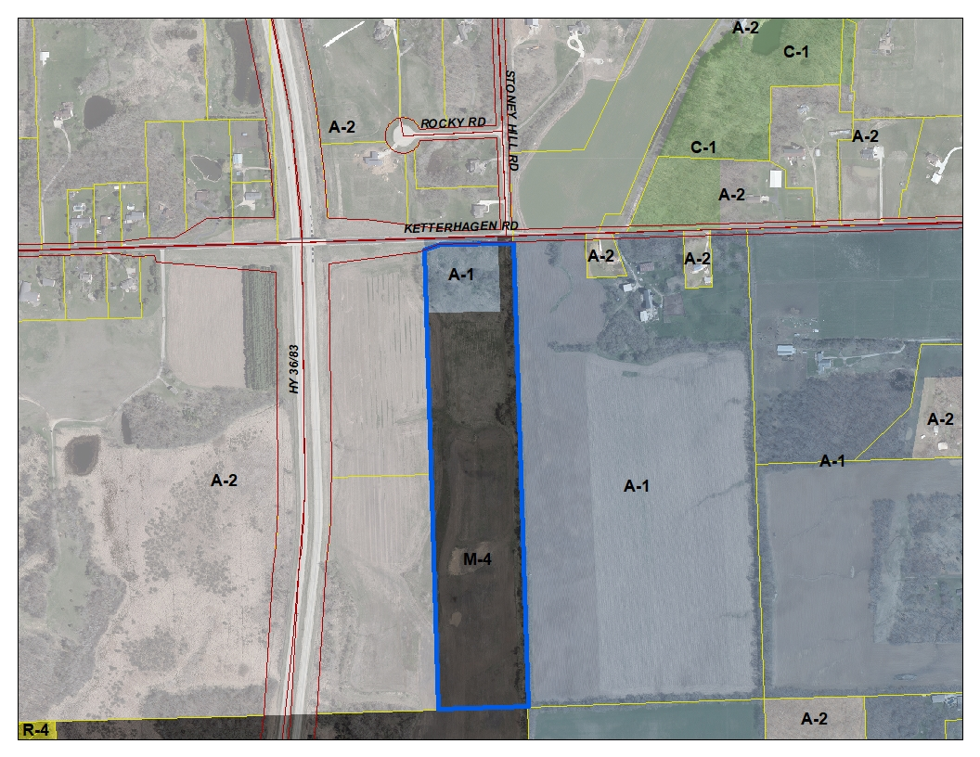
Kurt & Julie Petrie Living Trust, Owners
Site Address: west of 29019 Ketterhagen Road
Rezone from A-1 Farmland Preservation District & M-4 Quarrying District to A-2 General Farming & Residential District II
(Contains 29.88 acres)
Zoning Map
SEC 26 – T3N – R19E
Town of Burlington
Notes:
Notes:

Slide 4
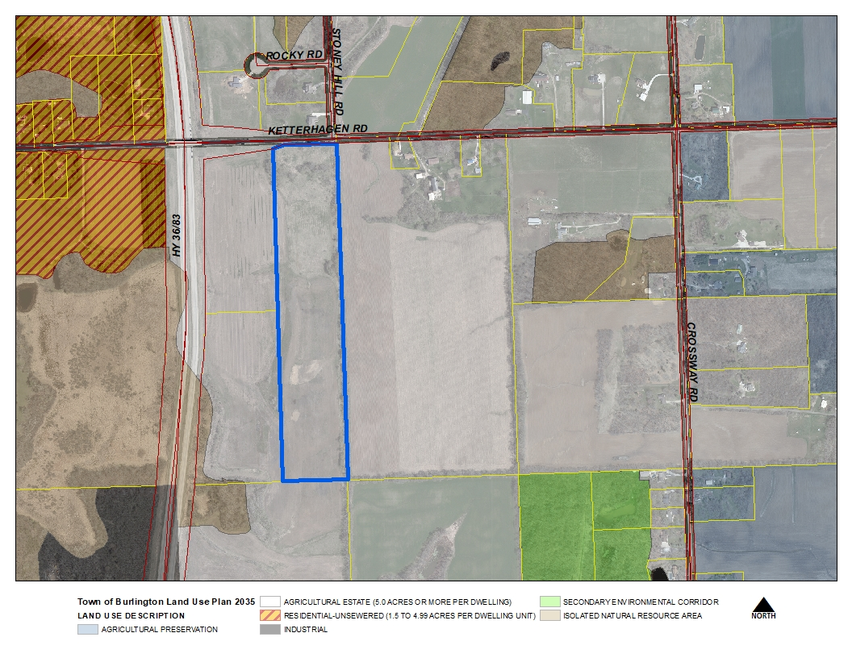
Kurt & Julie Petrie Living Trust, Owners
Site Address: west of 29019 Ketterhagen Road
Rezone from A-1 Farmland Preservation District & M-4 Quarrying District to A-2 General Farming & Residential District II
(Contains 29.88 acres)
Land Use Plan
SEC 26 – T3N – R19E
Town of Burlington
Notes:
Notes:

Slide 5
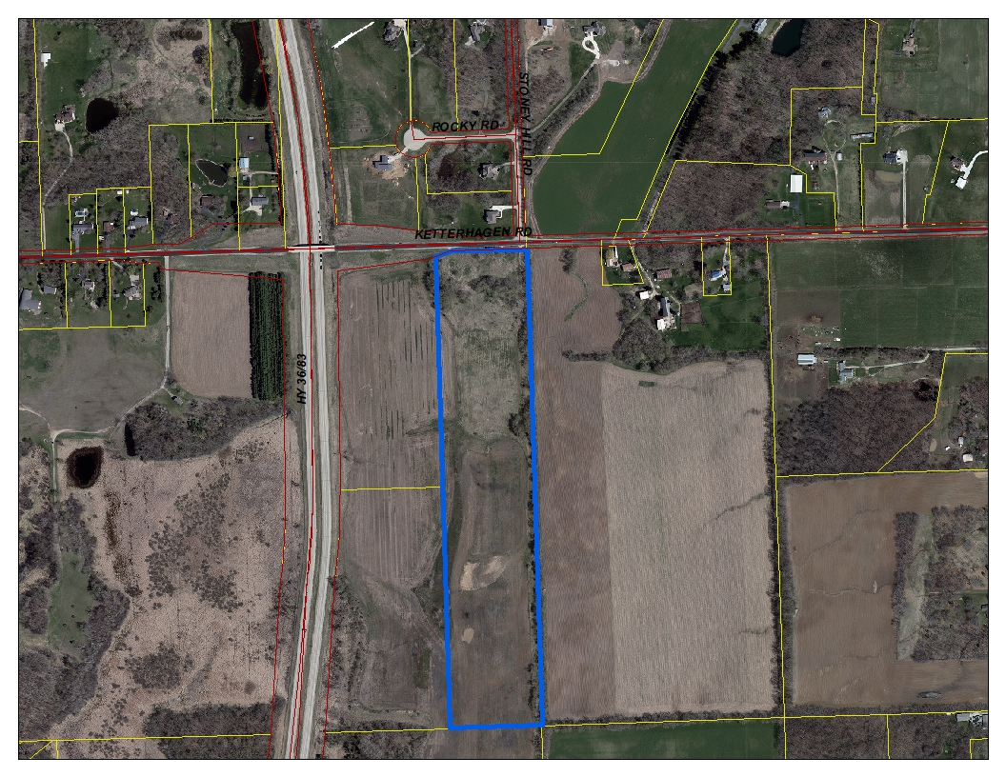
Kurt & Julie Petrie Living Trust, Owners
Site Address: west of 29019 Ketterhagen Road
Rezone from A-1 Farmland Preservation District & M-4 Quarrying District to A-2 General Farming & Residential District II
(Contains 29.88 acres)
2022 Aerial
SEC 26 – T3N – R19E
Town of Burlington
Notes:
Notes:

Slide 6
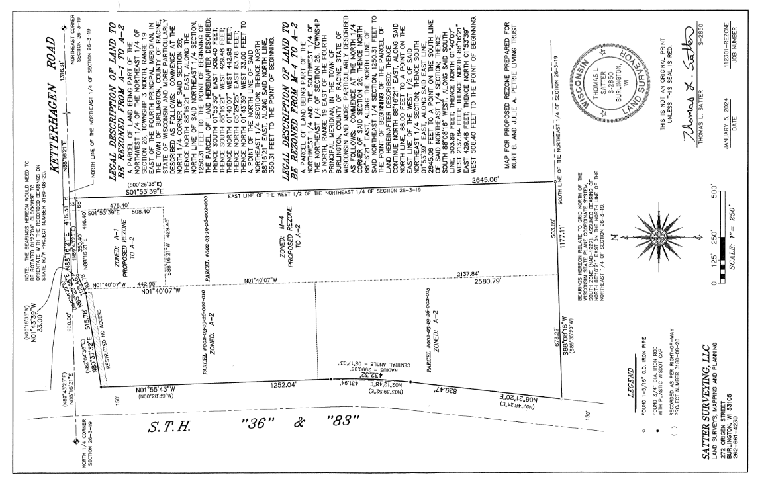
Kurt & Julie Petrie Living Trust, Owners
Site Address: west of 29019 Ketterhagen Road
Rezone from A-1 Farmland Preservation District & M-4 Quarrying District to A-2 General Farming & Residential District II
(Contains 29.88 acres)
Rezone Exhibit
SEC 26 – T3N – R19E
Town of Burlington
Notes:
Notes:

Slide 7
Final Plat Birchwood Reserve – Plat 2 (26 lots / 2 outlots) Town of Burlington Sec 22 – T3N – R19E
Notes:
Notes:

Slide 8
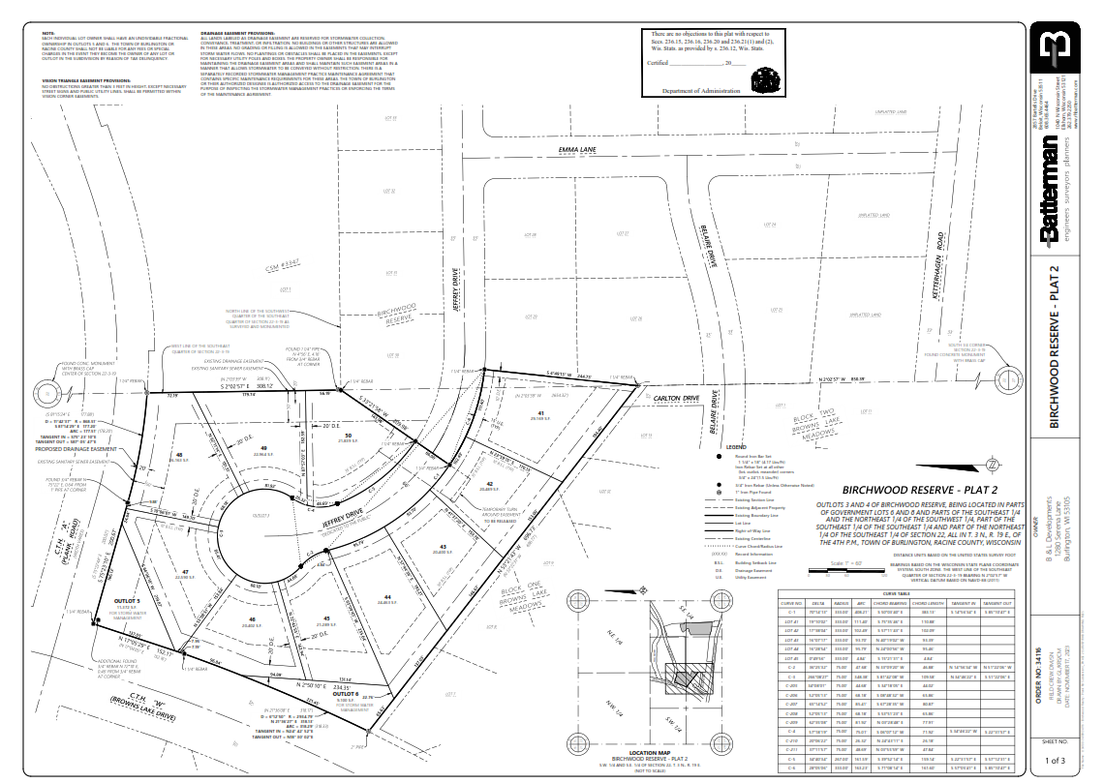
Notes:
Notes:

Slide 9
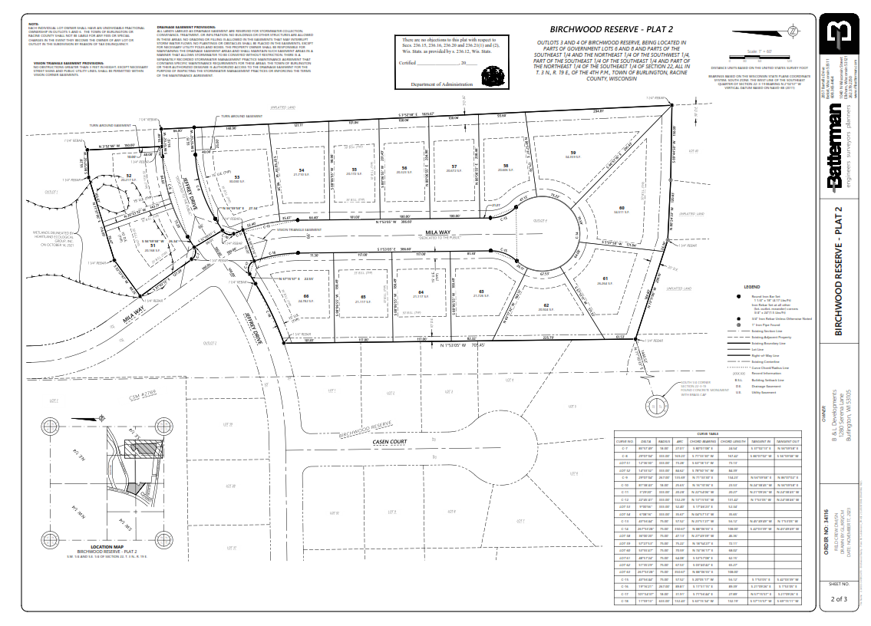
Notes:
Notes:

Slide 10
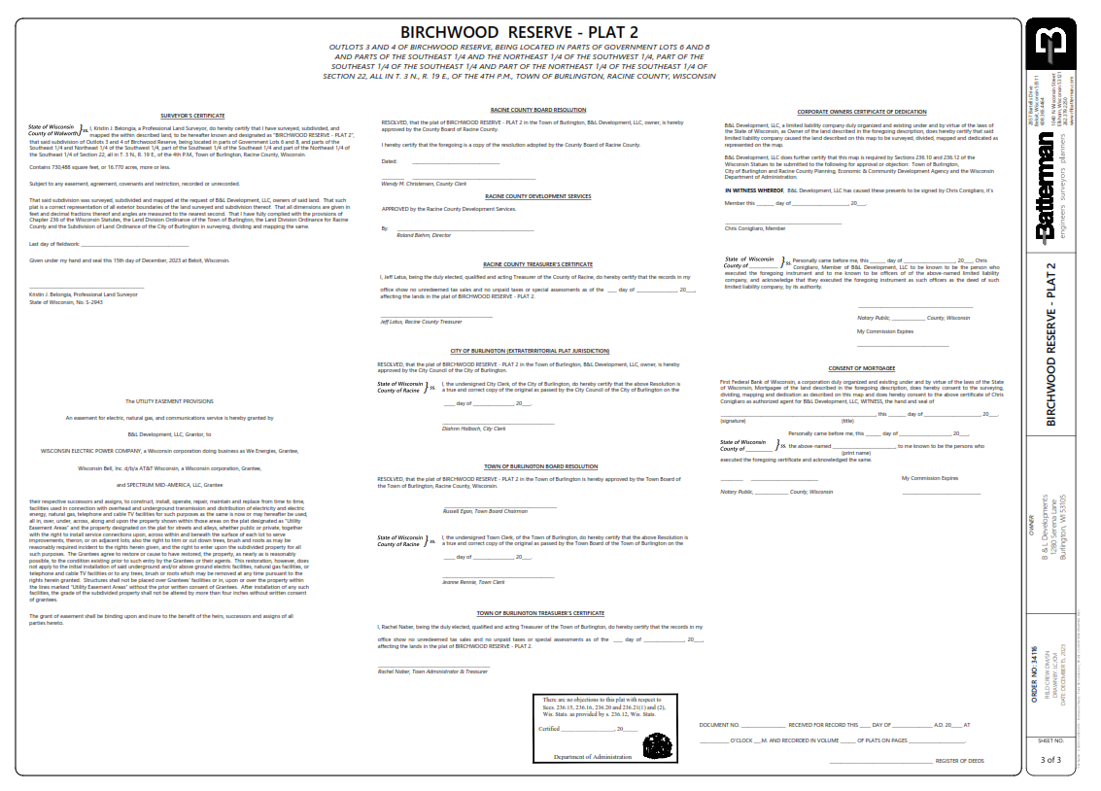
Notes:
Notes:

