Slide 1
Enhancing Cybersecurity for local government
Shuchi Wadhwa | Chief Information Officer | Racine County
2023

Slide 2
aGENDA
introduction
the fundamentals
we upped our security...up yours!
interagency security model - consortium
summary
call to action

Slide 3
INTRODUCTION
Who am I?

Slide 4
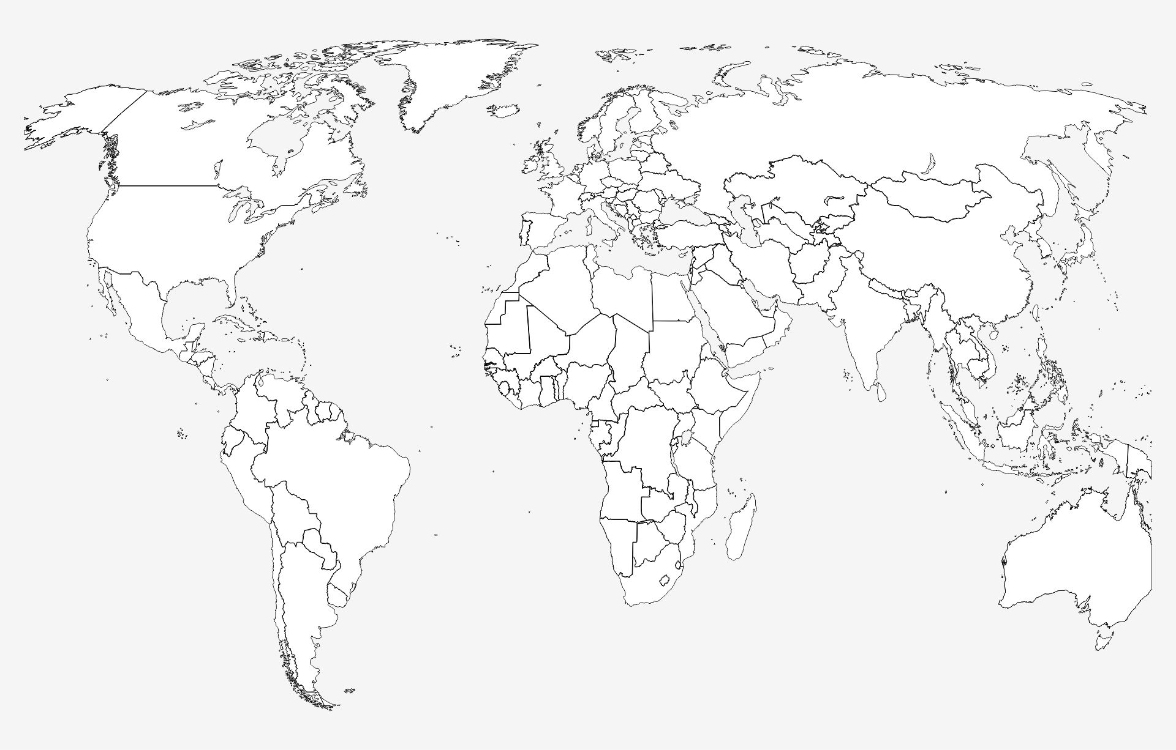
cybersecurity jobs: nearly 3.5 Million open cyber jobs to be filled in 2023
cybersecurity spending: estimated to exceed $188 Billion in 2023
average cost of data breach: $4.35 Million globally in 2022
organizational loss: $10.5 Trillion by 2025 = $19,977,168 per minute due to cybercrime
95% of all malware attacks delivered via email
ransomware costs: projected to cost $30 Billion globally in 2023

Slide 5
Ransomware infects City of Racine computer systems RACINE — City of Racine computer systems were infected by ransomware early
City of Oshkosh computer system hit by virus The City of Oshkosh has been hit by a computer virus that's impacting website, email and some phone lines.
As Kenosha responds to historic protests, the city faces cyberattacks or 'hacktivism'
KENOSHA, Wis. - The City of Kenosha has been fighting off cyberattacks since the shooting of Jacob Blake. They're called "denial of service" attacks -- which either flood a website with traffic or send it harmful information to make it crash.
Confidential information of 9,500 patients at the Medical College of Wisconsin compromised The compromised email accounts contained one or more of the following types of information: patients’ names, home addresses, dates of birth, medical record numbers, health insurance information, dates of service, surgical information, diagnosis or medical condition, and treatment information.
City of Fond du Lac online water payment system hacked Officials with the City of Fond du Lac say its Water Payment Portal has been hacked, and people who pay their water bill online through the system should check their credit card statements.
Village of Whitefish Bay targeted by cyber security attack
WHITEFISH BAY, Wis. (CBS 58) -- According to a news release, the Village of Whitefish Bay was targeted by a "malicious and sophisticated cyber security attack" on Saturday, July 31.
Wisconsin's statewide court system slowed by denial-of-service cyberattack An attempted cyberattack on the Wisconsin court system's computer network caused intermittent delays and slower response times earlier this week.
Ransomware group claims attack on Wisconsin school district
A ransomware group took responsibility for a cyberattack on a school district in Wisconsin serving nearly 20,000 students.
The Snatch ransomware group added the Kenosha Unified School District
Rock County Services suffers cybersecurity incident A phishing scam earlier this year led to a security breach within Rock County Human Services.
County Administrator Josh Smith says all affected parties have been contacted

Slide 6
WHO HAS YOU IN THEIR CROSSHAIRS?
criminals
motivation: Financial Gain
impact: Extortion of money, release of private information, operational disruption, brand and reputation damage
insiders
motivation: Personal advantage, monetary gain, revenge,
Patriotism
impact: Loss of competitive advantage, trade secret disclosure, operational disruption, brand and reputation damage
hacktivists
motivation: Negatively impact reputation, draw attention to cause, pressure change
impact: Operational disruption, brand and reputation damage, loss of confidence
nation-states
motivation: Economic, political and/or military advantage
impact: Loss of competitive advantage, operational disruption, brand and reputation damage

Slide 7
The fundamentals
Cybersecurity IS Risk Management

Slide 8
Complexity of a modern organization
email
mobile devices
website
social media
credit card transactions
BYOD and office policy
network management
backup and remote access

Slide 9
Managing cyber risk mitigation vs. elimination of risk
inherent risk
Risk 1
Risk 2
Risk 3
residual risk
controls

Slide 10
Main cyber threats affecting local government
phishing
Social engineering attack involving trickery
ransomware
Type of software with malicious intent and a threat to harm your data
hacking
Unauthorized access to systems and information
Natural threats such as fire, earthquake, flood can cause harm to computers or disrupt business access
environmental threats
Designed to gain access to systems or steal data
Targeted phishing is “spear phishing”
Variants include “vishing” – attacks by telephone and “smishing” those using SMS or text
The author or distributor requires a ransom to undo the damage
No guarantee the ransom payment will work
Ransom often needs to be paid in cryptocurrency
Website attack such as DDOS (distributed denial of service)
Access denied to authorized users
Stolen funds or intellectual property
Recovery efforts attract scams such as financial fraud
Downtime can lose customers, clients who can’t wait

Slide 11
Small organization, big impact
why put your already limited resources into preparing for and protecting against cybersecurity attacks?
vulnerability
business costs
reputation
Attackers can see small organization as easy targets
Attacks can be extremely costly and threaten the viability of your organization
Residents and employees expect and trust you to keep their information secure

Slide 12
We upped our security…up yours!

Slide 13
Cyber measures taken and cost per person
description | annual cost per user – msrp | annual cost per user – negotiated
microsoft applications & security tools | $538.46 | $538.46
email filter & security training | $140.77 | 38.46
file/network scanning | $190.00 | $61.54
firewall | $86.67 | $45.38
anti-virus/policies | $47.44 | $33.08
multifactor authentication | $55.00 | $55.00
active directory auditing/management | $2.49 | $2.07
network vulnerability scanning | $62.05 | $18.46
annual cost per user | $1,122.88 | $792.45
monthly cost per user | $93.57 | $66.04
average discount = 29.4%

Slide 14
illustration
annual cost per user: $792.45
average cost of data breach: $4.35 Million
user count:
100
break even (years):
55
Can your organization go 55 years without an incident?

Slide 15
Interagency security model | consortium

Slide 16
Challenges affecting local governments
money
resources
competing priorities

Slide 17
Problem statements
economies of scale
What if we could leverage existing tool sets used in local government (and/or the State) and make them available to our partners so that they could enable capabilities they did not previously have due to costs, limited resources, and other general challenges?
achieve efficiencies
What if we could achieve economies of scale, reduce overall costs, maximize efficiencies, improve knowledge transfer, reduce duplication of work, and remove the haves and have-nots which has historically been one of the most significant challenges facing local governments.
enhance cybersecurity for all
How can we bring local governments and organizations above the cyber poverty line, so it protects everyone in the ecosystem?

Slide 18
Goal:
To seed the creation of this community, it is imperative that the effort has broad support from key industry partners who are interested in securing their products, services, and data. Service providers are an integral resource as well.
Mission:
Build an active, trusted network of local governments and academia to enhance cybersecurity resilience and response, better protect digital and physical assets, create safer and stronger communities, and advance the technology leadership of southeastern Wisconsin and Wisconsin in general.
vision:
Reduction of overall costs through economies of scale
Increase resilience and visibility
Develop long-term strategy to prepare participating members for emerging and long-term cyber security challenges
Maximized efficiencies and reduced duplication of work
Increased knowledge sharing through engaging network of cybersecurity professionals
Stimulate open innovation and impact throughout consortium

Slide 19
Avenues
collaborative defense
workforce development
community outreach
interagency security model | consortium

Slide 20
Collaborative defense
Members share (in private community composed of vetted, trusted peers) practical cybersecurity defense information that can be put to immediate use. This includes best practices, proven methods and approaches, incident information, techniques/policies/procedures, indicators of compromise, etc. Due to diverse membership consisting of local government and academia, it will provide unique cross industry perspectives.
Facilitate joint government contract pricing and/or grant applications among members on technology related to cyber defense
Develop a secure web-based forum and resource library for members to collaborate on technologies, share best practices, and gather resources/information
Host events focused on cybersecurity
Develop and facilitate Executive Peer Forum for members

Slide 21
Workforce development
Work across member organizations to build internal cybersecurity expertise and create local and regional employment opportunities. Due to academia being engaged with this effort, we will be able to create and support programs that expand the cybersecurity talent pool and help to create cyber-ready graduates to meet industry need.
Establish and grow graduate level expertise in educational institutions within southeastern Wisconsin
Facilitate a pipeline of adjunct instructors from industry to teach up-to-date technology/cybersecurity courses
Recruit and/or establish private cyber training companies

Slide 22
Community outreach
Collaborate with a variety of partners to improve community and regional cybersecurity preparedness and response ensuring that cybersecurity is a business development priority within southeastern Wisconsin’s economic growth strategy.
Meet with state/federal representatives to educate them on our specific cyber challenges for our area
Develop educational and best practices document for distribution to member’s constituencies/customers
Assist member executives in raising awareness of the realities and risks to their organizations regarding likely cyber-attacks

Slide 23
Return on investment
cybersecurity help now!
community investment
recruitment investment
The near-term objective and work plan include immediate benefits in peer-to-peer communications and information sharing, workforce development, and education for the public and policymakers
Increase visibility and access to more resources!
The cybersecurity challenge is a long-term war. Joining the consortium as a member strengthens the effort and strengthens your own individual efforts within your respective organizations
A strong cyber ecosystem will consist of a strong pipeline of talented people. Developing the pipeline in your own backyard is a cost-effective recruitment strategy

Slide 24
How to measure success
ESTABLISH FRAMEWORK
With establishing key principles, policies, tools it will result in better protection of digital assets and creation of stronger safer communities
ESTABLISH METRICS
With establishing key metrics (uptime, time to remediate, number of incidents) it will establish baseline measures, identify areas for improvement and promote ongoing learning
INCREASED PARTICIPATION
As more regional partner participate the consortium becomes a powerful network leveraging a wide range of expertise, resources, and perspectives
Through leveraging economies of scale through shared resources, tools and technologies the consortium reduces overall costs and more efficiently allocates resources towards cybersecurity for each partner
ECONOMIES OF SCALE

Slide 25
summary

Slide 26
Key take-aways
Decreased costs due to economies of scale on complete services from segment leaders deploying high-tier package
Enhanced cybersecurity for all, due to our duty to protect our own
Investment in community by building relationships and fostering workforce development

Slide 27
Call to action

Slide 28
essential elements to build a “culture of cyber readiness” …Action for leaders…
Yourself
Lead Investment in basic cybersecurity
Your Staff
Develop a culture of awareness to encourage employees to make good choices online Learn about risks: phishing, business email compromise, etc
Maintain awareness on current events
Your Systems
Learn what is on your network.
Maintain inventories of hardware and software assets to know what is in play and at-risk from attack
Work in conjunction with your technology department to implement basic cyber measures (ie/MFA, policies and procedures, etc)
Your Surroundings
Your Crisis Response
Your Data
Determine how much of your organization's ops are dependent on technology
Build trusted network of relationships
Approach cyber as a business risk
Learn how your data is protected
Lead development on: - Incident response/DR planning
- Prioritization of resources and identification of critical systems that must be recovered first
- Internal reporting structure to detect, communicate, and contain attacks
Learn who to call for help (relationships matter!)

Slide 29
THANK YOU
Shuchi Wadhwa
Shuchi.Wadhwa@racinecounty.com

