Slide 1
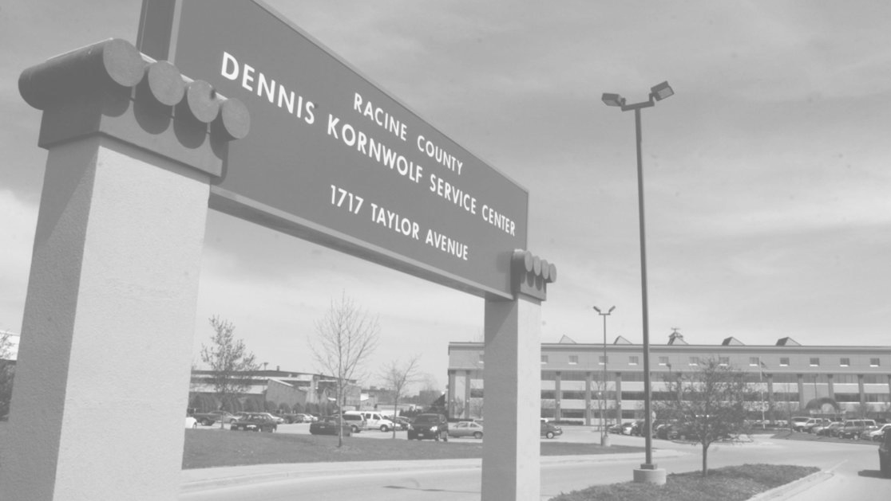
2 0 2 3
ASSISTED LIVING IN RACINE COUNTY

Slide 2
HISTORY OF LONGTERM CARE IN WISCONSIN
INSTITUTIONALIZATION
1897 - Northern
1919 - Southern
1959 - Central
1981
COP created - expanded to CIP I, CIP II, BIW
1999
Olmstead Act
2007
Family care comes to Racine
1970'S
Movement to reduce reliance on institutions
1995
Closed long-term admissions to Southern
2005
ICP-MR’s start closing
Notes:
2005 Notes: Intermediate care facility for individual disabilities 1999 – 2974 people by 2008 945 people
2009 16 ICF-MRs with 1,053 beds; Racine Residential ICF-MR 51 beds closed 12/31/2009
St. Colettas 50 Beds / 9/30/2010; Bethesda 40 beds 8/31/2010; SWC 70 Beds 6/30/201

Slide 3
Assisted Living or Group Homes are terms commonly used to describe community living arrangements.
LEGAL ENTITIES
CERTIFIED 1-2 BED ADULT FAMILY HOME
STATE LICENSED ADULT FAMILY HOME
COMMUNITY- BASED RESIDENTIAL FACILITY
RESIDENTIAL CARE COMPLEX
NURSING HOME

Slide 4
NURSING HOME
A nursing home is defined in Wis. Stat. § ch. 50.01(3) as a place where five or more people (who are not related to the operator) live because they need 24-hour nursing care. This can include limited nursing care, intermediate level nursing care, and skilled nursing services.
Nursing Homes are regulated by the Division Of Quality Assurance.

Slide 5
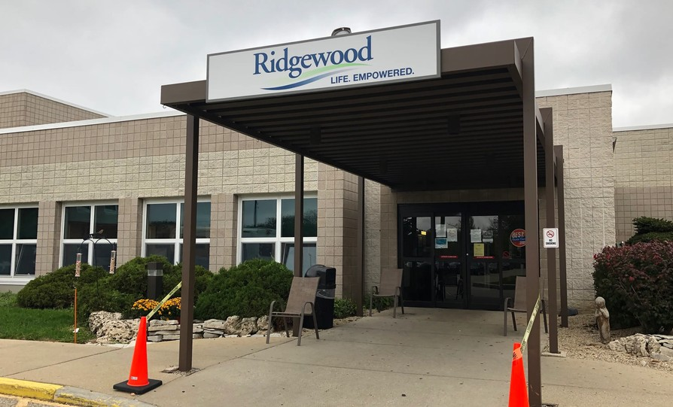
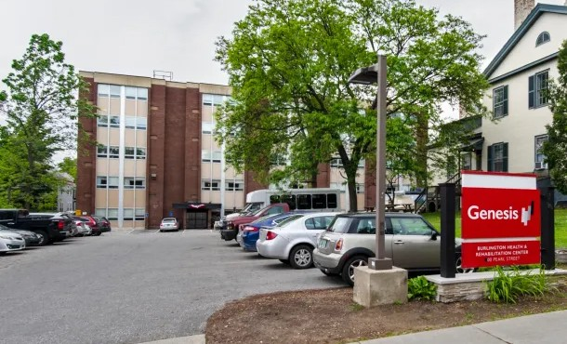
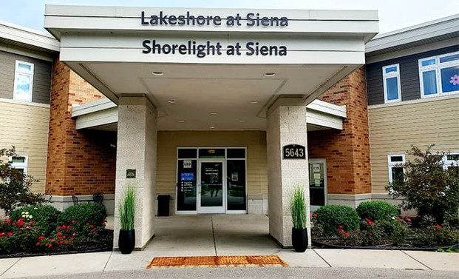
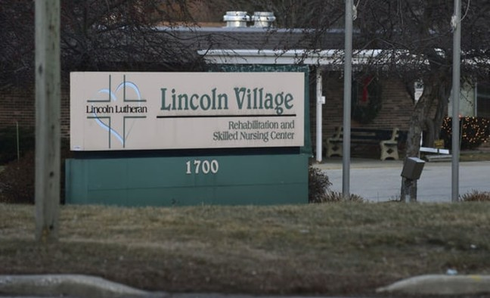
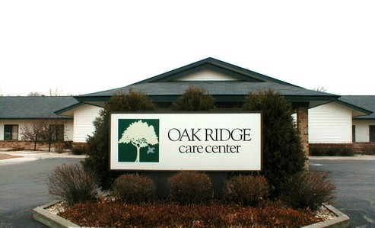
NURSING HOMES IN RACINE COUNTY
Burlington Health and Rehabilitation Center
Ridgewood
Lakeshore at Siena
Lincoln Park Nursing and Rehab LLC
Oak Ridge Care Center

Slide 6
RESIDENTIAL CARE APARTMENT COMPLEXES
Residential Care Apartment Complexes (RCACs) are independent apartment units that provide services including:
Room and board
Up to 28 hours per week of supportive care Personal care
Nursing services
RCACs are regulated by the Division of Quality Assurance.

Slide 7
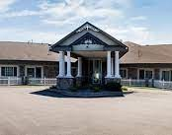
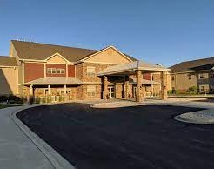
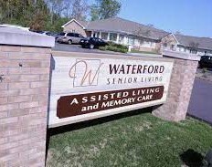
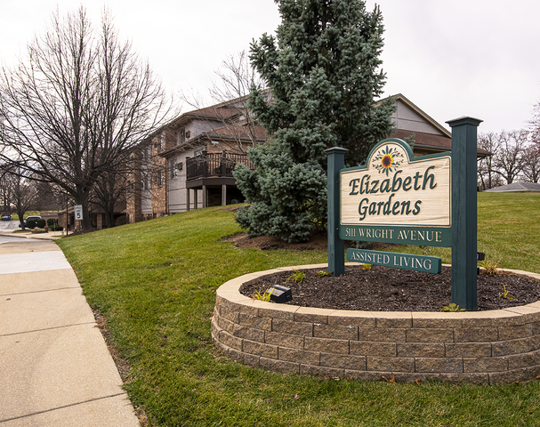
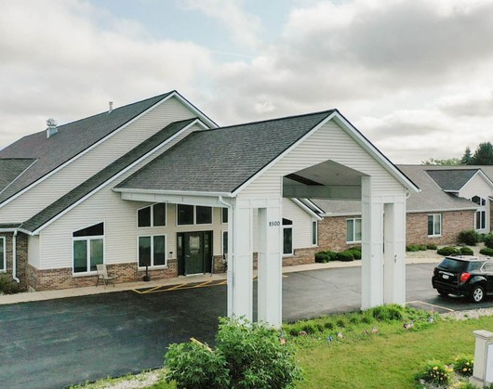
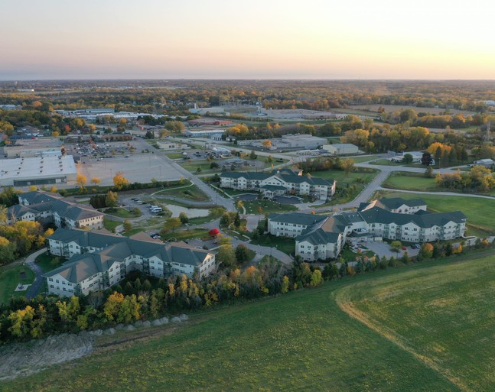
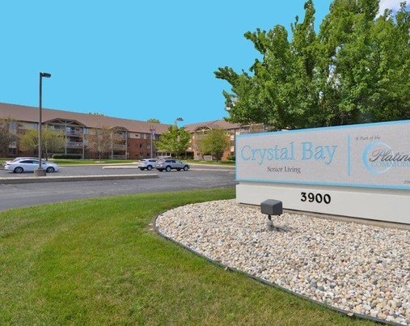
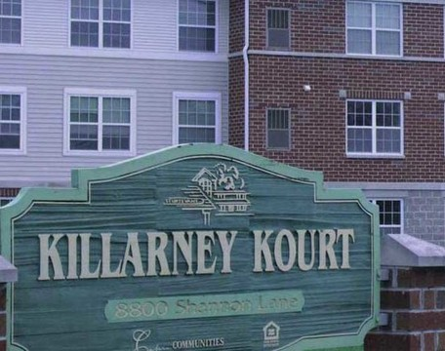
RESIDENTIAL CARE COMPLEXES IN RACINE COUNTY
Home Harbor
Primrose of Mt. Pleasant
Waterford Senior Living
Elizabeth Gardens
Pleasant Point Senior Living
Parkview Gardens
Pillars at Crystal Bay
Killarney Kourt

Slide 8
COMMUNITY-BASED RESIDENTIAL CARE FACILITY
Community-based residential facilities (CBRF) are places where five or more unrelated people live together in a community setting. Services offered include room and board, supervision, and support services. It can include up to three hours of nursing care per week.
CBRFs are regulated by the Division Of Quality Assurance
39 CBRFS ARE LOCATED IN RACINE COUNTY. OFTEN, RESIDENTIAL CARE COMPLEXES WILL ALSO HAVE AN AREA THAT IS A CBRF.

Slide 9
STATE REGULATED ADULT FAMILY HOMES
An adult family home is defined in Wis. Stat. § 50.01(1)
(b) as a place where three or four adults who aren't related to the operator reside. They receive care, treatment, or services that are above the level of room and board. It may include up to seven hours per week of nursing care per resident.
These homes are regulated by the Division of Quality Assurance.
276 STATE LICENSED ADULT FAMILY HOMES WITH ROUGHLY 1,100 BEDS ARE LOCATED IN RACINE COUNTY.

Slide 10
CERTIFIED ADULT FAMILY HOMES
Under Wis State 46.036, Wisconsin Department of Health Services establishes 1-2 bed AFH certification. These standards are issued under the authority of Medicaid Home and Community Based Services waivers.
Counties, Dept of Health Services managed Care Organizations such as Family Care, Partnership, PACE or IRIS can certify and serve as placing agencies.
THERE IS NOT A STATE WIDE DIRECTORY OF THESE PROVIDERS there are over 84 facilities- 168 beds.
NEED TO SEARCH THE PROVIDER NETWORKS FOR THE VARIOUS MCOS THAT ARE UNDER CONTRACT WITH THE STATE OF WISCONSIN TO CERTIFY A HOME IN RACINE COUNTY.

Slide 11
COMMON QUESTIONS
Who oversees the facilities?
What if the facility is doing a poor job of managing their residents?
Our community is saturated with
facilities, how can we stop this? How do I complain about facilities? Other questions?

Slide 12
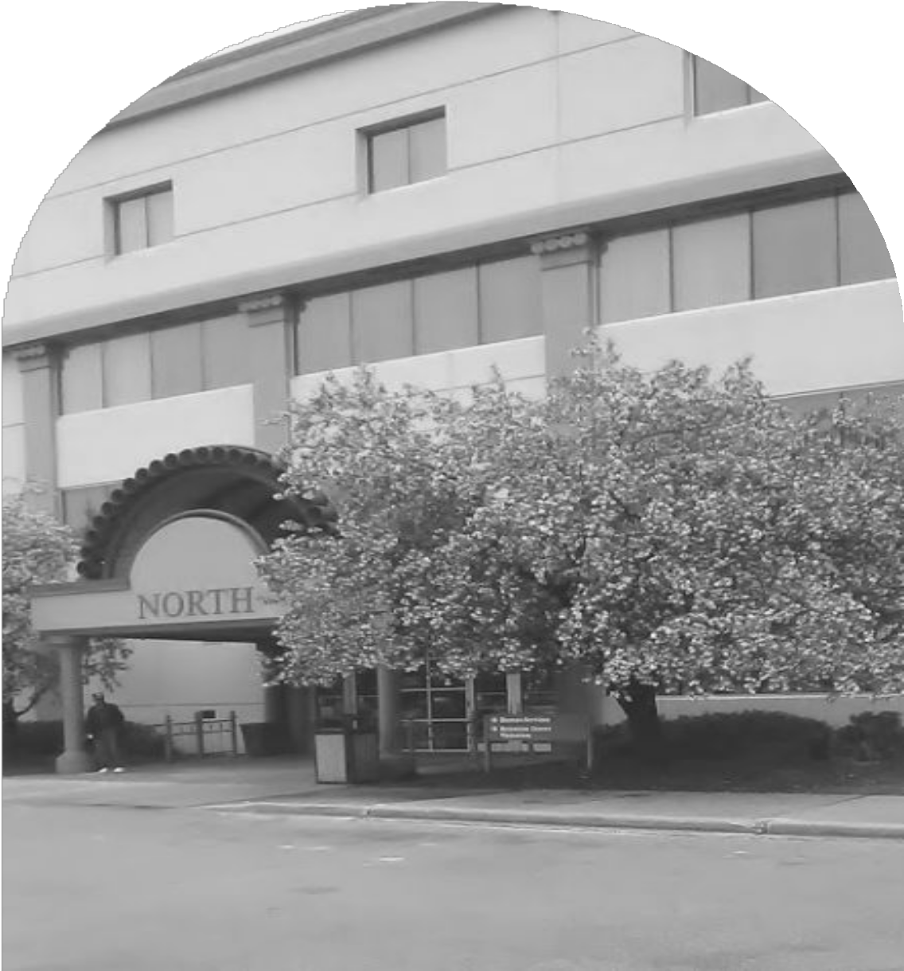
THANK YOU
Resources:
Division Of Quality Assurance Provider Guide and directories
https://www.dhs.wisconsin.gov/guide/provider-search.htm
Online Complaint for DQA
https://www.dhs.wisconsin.gov/guide/complaints.htm
Regulations related to certified homes:
https://www.dhs.wisconsin.gov/publications/p0/p00638.pdf

