Slide 1
RACINE COUNTY
Race, Equity, and Inclusion Analysis
Performance and Analytics Division

Slide 2
"Transparency forms the cornerstone of an open government and promotes accountability and civic engagement"
- Racine County Transparency Ordinance

Slide 3
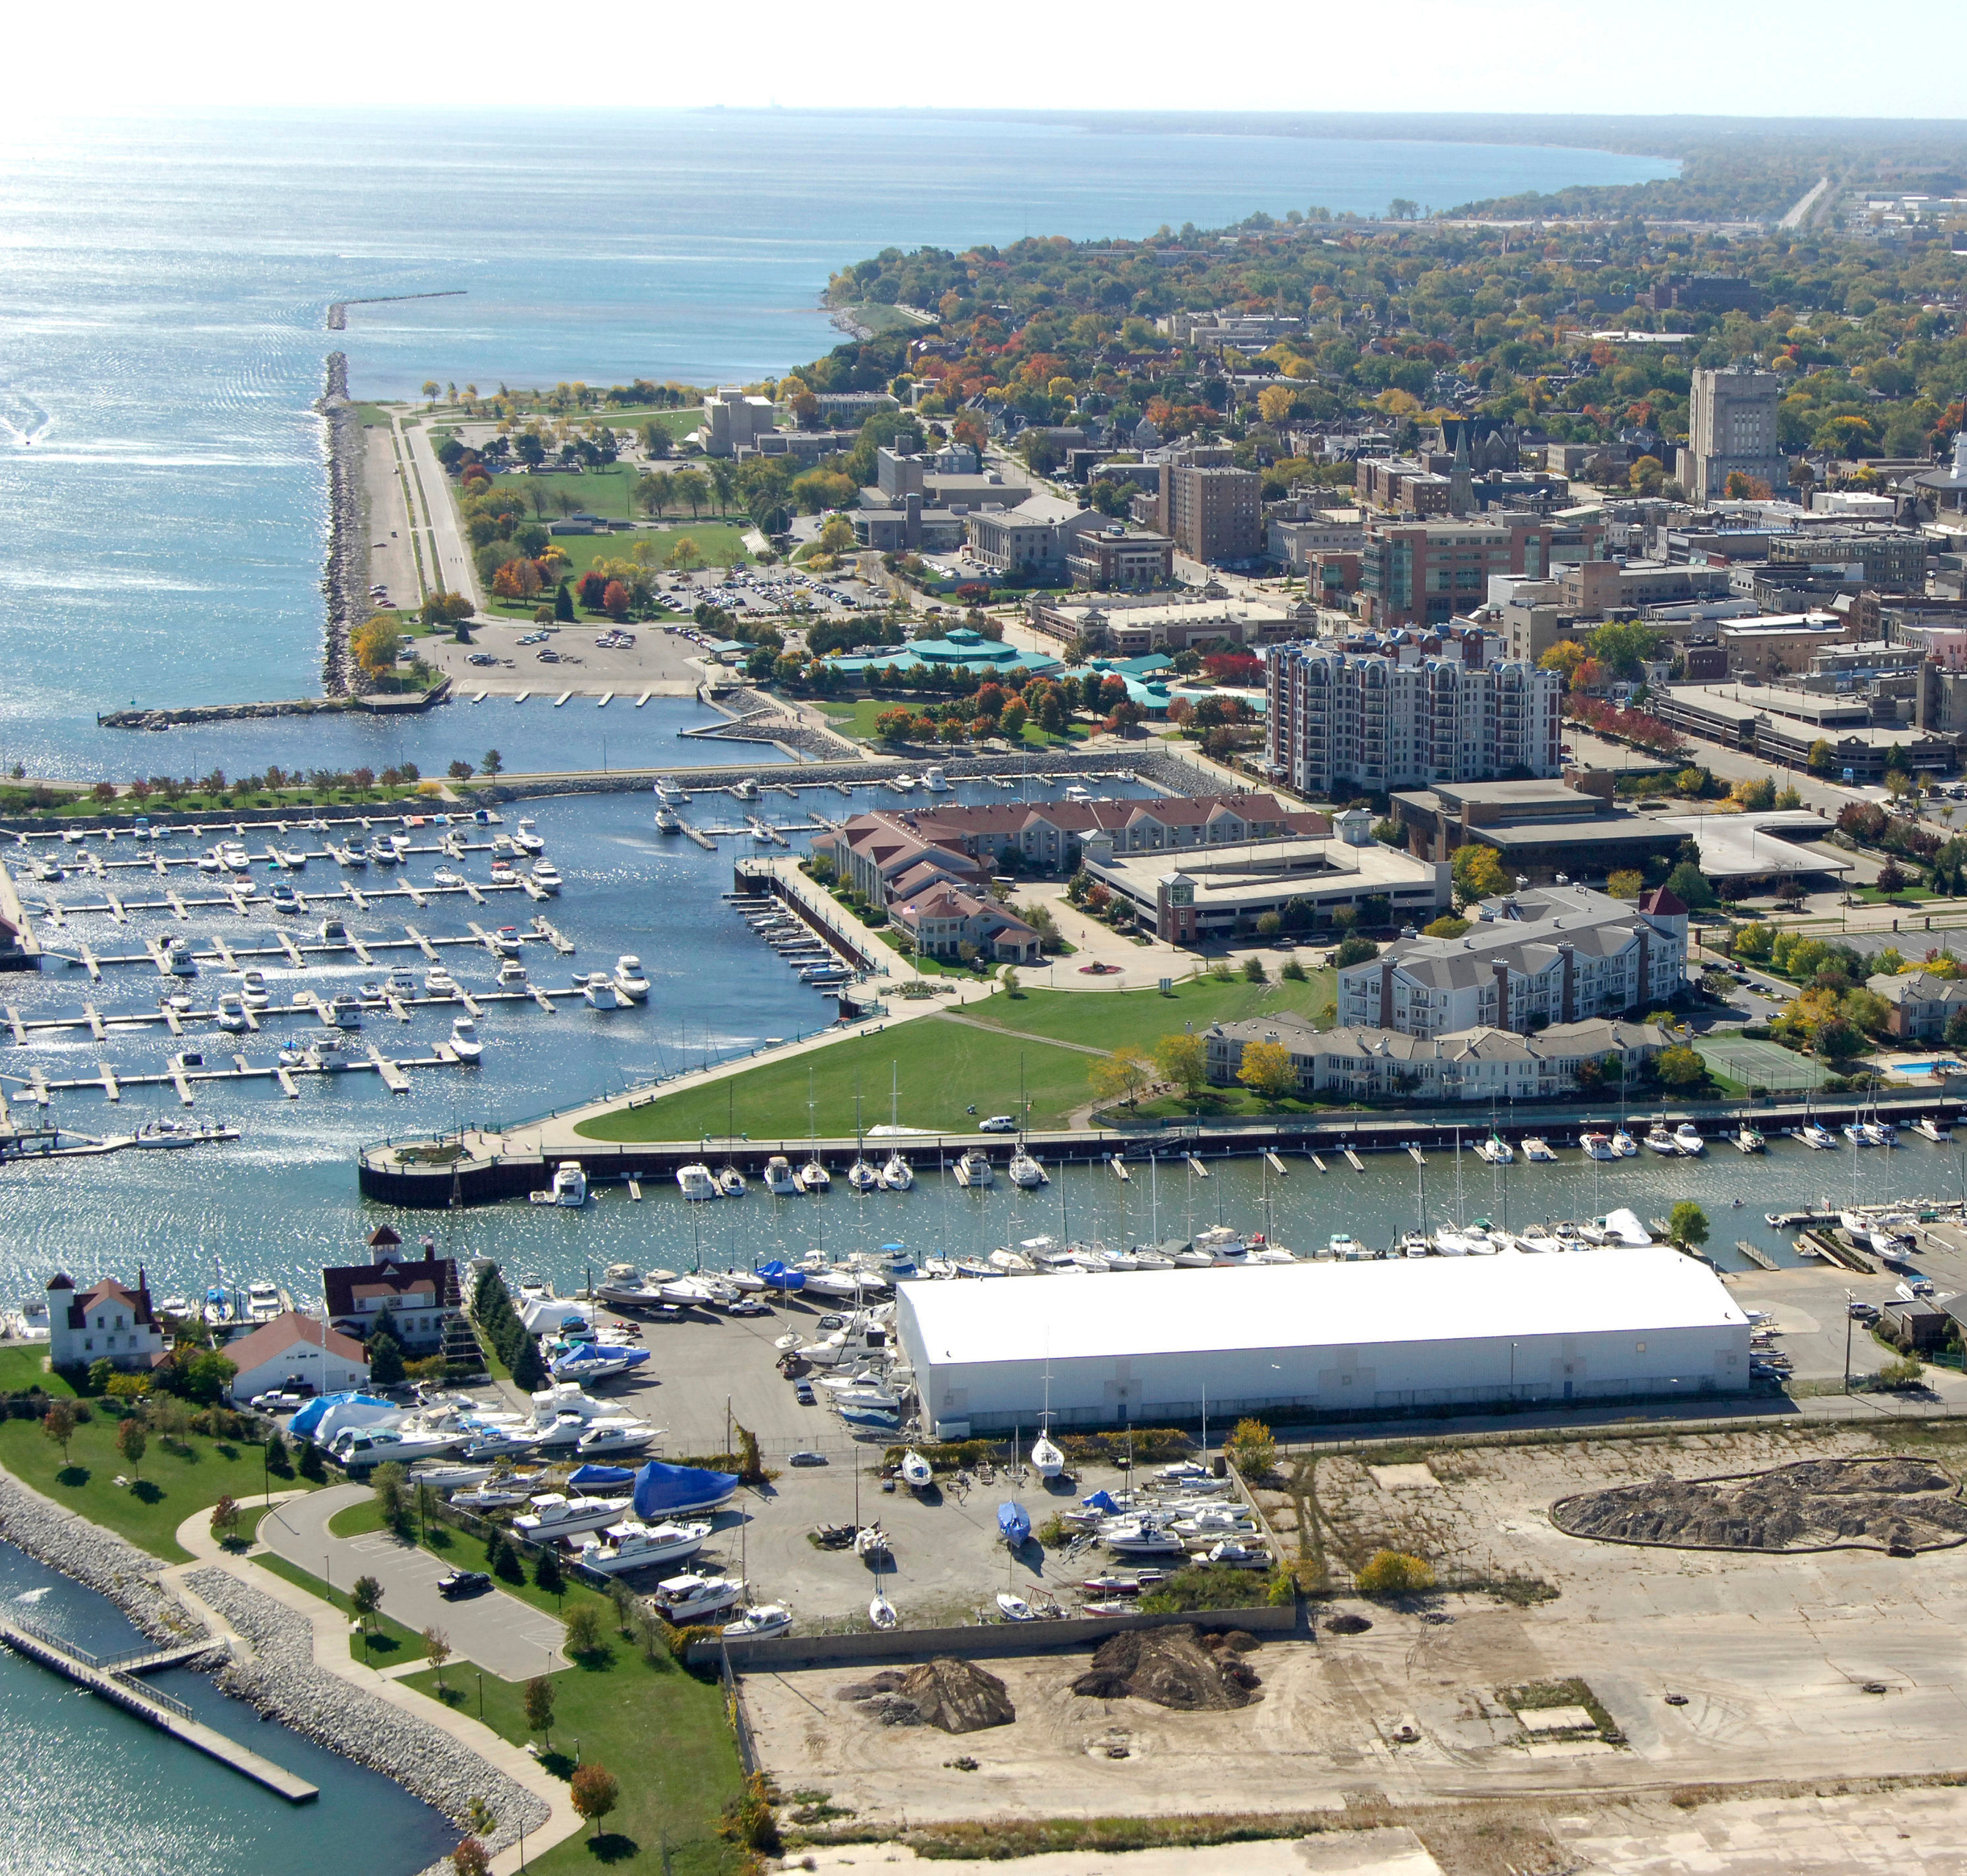
KEY QUESTIONS
Q1: Does staff diversity reflect community diversity?
Q2: Does staff diversity reflect customer diversity across key positions and departments?
Q3: How diverse is Racine County leadership?
Q4: Are wages different between white and minority staff or male and female staff for the same positions?
Q5: Are wages different between white and minority staff? If so, what explains wage differences by race and ethnicity?
Q6: Are wages different between male and female staff? If so, what explains wage differences by gender?
REI Analysis 2020

Slide 4
QUESTION #1
DOES STAFF DIVERSITY REFLECT COMMUNITY DIVERSITY?
REI Analysis 2020

Slide 5
Does staff diversity reflect community diversity?
White
75.7%
White
72.4%
Black
12.6%
Black
10.9%
Hispanic
10.7%
Hispanic
12.9%
Non-White
24.3%
Non-White
27.6%
Source: 2020 Racine County staffing and 2018 American Community Survey 5-Year Estimates
0
10
20
30
40
50
60
70
80
County Staff
Community
REI Analysis 2020

Slide 6
Does staff diversity reflect community diversity?
Men
51.3%
Men
49.5%
Women
48.7%
Women
50.5%
Source: 2020 Racine County staffing and 2018 American Community Survey 5-Year Estimates
0
10
20
30
40
50
60
70
80
County Staff
Community
REI Analysis 2020

Slide 7
QUESTION #2
DOES STAFF DIVERSITY REFLECT CUSTOMER DIVERSITY ACROSS KEY POSITIONS AND DEPARTMENTS?
REI Analysis 2020

Slide 8
Does staff diversity reflect customer diversity across key positions and departments?
CASE MANAGERS, HEALTH AND HUMAN SERVICES
80
70
61.1%
60
58.5%
50
46.3%
White
40
32.9%
Black
Underrepresented among case managers and all HSD staff
30
22.6%
22.6%
20
18.9%
15.1%
17.4%
Hispanic
Fairly represented among case managers and all HSD staff
10
Source: 2020 Racine County staffing and EEO survey results
0
Case Managers/
Social Workers
Health and Human Services Staff
Health and Human Services Customers
REI Analysis 2020

Slide 9
Does staff diversity reflect customer diversity across key positions and departments?
83.3%
CASE MANAGERS, HEALTH AND HUMAN SERVICES
80
71.1%
70
60
51.1%
Women
Men significantly underrepresented among case managers/social workers and all HSD staff
50
48.9%
Men
40
28.9%
30
20
16.7%
10
Source: 2020 Racine County staffing and EEO survey results
0
Case Managers/
Social Workers
Health and Human Services Staff
Health and Human Services Customers
REI Analysis 2020

Slide 10
Does staff diversity reflect customer diversity across key positions and departments?
80
70
63.0%
Black
Underrepresented among detention workers and staff
60
55.6%
51.2%
DETENTION WORKERS,
HEALTH AND HUMAN SERVICES
50
37.0%
39.0%
40
30
23.8%
White
20
9.8%
10.4%
Slightly underrepresented among detention workers and staff
10
7.4%
Hispanic
Source: 2020 Racine County staffing and 3-year Juvenile Detention demographic data
0
Detention
Workers
Juvenile Detention
Staff
Juvenile Detention
Population
REI Analysis 2020

Slide 11
Does staff diversity reflect customer diversity across key positions and departments?
CORRECTIONS OFFICERS,
SHERIFF'S OFFICE
80
67.3%
66.9%
70
60
50
43.4%
Black
Significantly underrepresented among corrections officers and jail staff
40
40.6%
White
30
20
16.8%
17.8%
14.7%
Hispanic
Fairly represented among corrections officers and jail staff
15.8%
15.3%
10
Source: 2020 Racine County staffing and
1-year Corrections demographic data
0
Corrections
Officers
Sheriff's Office
Jail Staff
Sheriff's Office
Jail Population
REI Analysis 2020

Slide 12
65.9%
90%
81.2%
Does staff diversity reflect customer diversity across key positions and departments?
80
72.4%
White
70
60
50
DEPUTIES,
SHERIFF'S OFFICE
40
30
20
12.9%
Hispanic
Underrepresented among deputies and Sheriff's Office
10.9%
Black
Underrepresented among deputies and Sheriff's Office
10
5.5%
9.6%
Source: 2020 Racine County staffing and 2018 American Community Survey 5-Year Estimates
8.6%
4.5%
0
Deputies
Sheriff's Office
and Jail Staff
Sheriff's Office
Population
REI Analysis 2020

Slide 13
65.9%
90.1%
81.5%
Does staff diversity reflect customer diversity across key positions and departments?
DEPUTIES,
SHERIFF'S OFFICE
80
70
60
50.5%
Women
Significantly underrepresented among deputies and Sheriff's Office
50
Men
49.5%
40
30
18.5%
20
9.9%
10
Source: 2020 Racine County staffing and 2018 American Community Survey 5-Year Estimates
0
Deputies
Sheriff's Office
and Jail Staff
Sheriff's Office
Population
REI Analysis 2020

Slide 14
QUESTION #3
HOW DIVERSE IS RACINE COUNTY LEADERSHIP?
REI Analysis 2020

Slide 15
How diverse is Racine County leadership?
Leadership Diversity
ACROSS ALL COUNTY LEADS, SUPERVISORS, MANAGERS, DIRECTORS, AND ELECTED OFFICIALS, BELOW IS THE PERCENT OF LEADERS WITHIN EACH RACIAL AND ETHNIC CATEGORY:
20.6%
11.9%
14.9%
of White staff are in
leadership roles
of Black staff are in
leadership roles
of Hispanic staff are
in leadership roles
White
Black
Hispanic
Source: 2020 Racine County staffing
REI Analysis 2020

Slide 16
WHITE STAFF ARE
1.7x
MORE OFTEN IN COUNTY LEADERSHIP ROLES THAN BLACK STAFF
REI Analysis 2020

Slide 17
Black leaders are disproportionately in
"entry-level" leadership roles
How diverse is Racine County leadership?
1 out of 13 (7.7%) Black leaders
Elected officials/directors
(11.4% of leadership roles)
4 out of 13
(30.8%)
Mid-tier managers
(52.5% of leadership roles)
Black leaders
8 out of 13 (61.5%)
Black Leaders
Leads/supervisors
(36.1% of leadership roles)
Source: 2020 Racine County staffing
REI Analysis 2020

Slide 18
How diverse is Racine County leadership?
Leadership Diversity
ACROSS ALL COUNTY LEADS, SUPERVISORS, MANAGERS, DIRECTORS, AND ELECTED OFFICIALS, COUNTY LEADERSHIP CLOSELY REFLECTS
COUNTY STAFF BY GENDER.
51.2%
48.8%
of leaders are men
of leaders are women
51.3%
48.7%
of staff are men
of staff are women
Men
Women
Source: 2020 Racine County staffing
REI Analysis 2020

Slide 19
QUESTION #4
ARE WAGES DIFFERENT BETWEEN WHITE AND MINORITY STAFF OR MALE AND FEMALE STAFF FOR THE SAME POSITIONS?
REI Analysis 2020

Slide 20
RACE, ETHNICITY, AND GENDER ARE INSIGNIFICANT WAGE FACTORS FOR SAME POSITIONS
However, other factors may impact wages and long-term earning potential of minority and female staff.
REI Analysis 2020

Slide 21
QUESTION #5
ARE WAGES DIFFERENT BETWEEN WHITE AND MINORITY STAFF?
IF SO, WHAT EXPLAINS WAGE DIFFERENCES BY RACE AND ETHNICITY?
REI Analysis 2020

Slide 22
$11,100
24%
Additional average annual income of White staff compared to Black staff
Additional average income earned by White staff as a percentage of average Black annual income
$8,000
16%
Additional average annual income of White staff compared to Hispanic staff
Additional average income earned by White staff as a percentage of average Hispanic annual income
REI Analysis 2020

Slide 23
Are wages different between white and minority staff? If so, what explains wage differences by race and ethnicity?
60
50
44.0%
9.2% of Black staff are in the top 25% of County earners yet 44.0% are in the bottom 25%
40
28.7%
32.2%
30
18.5%
20
10
9.2%
10.3%
0
Top 25% Earners
Bottom 25% Earners
Source: 2020 Racine County staffing
White
Black
Hispanic
REI Analysis 2020

Slide 24
WHAT FACTORS MAY CONTRIBUTE TO LOWER
MINORITY WAGES?
LOW
RETENTION
LIMITING POTENTIAL
LIMITING
OPPORTUNITIES
White staff on average work at Racine County for 9.5 years (5.7 median years). Black staff on average work 5.3 years (1.5 median years), and Hispanic staff on average work 7.1 years (3.1 median years).
67.9% of Black staff and 58.6% of Hispanic staff work in a detention facility, on the phone, or front line with customers.
13 out of 166 (7.8%)
County leadership positions are held by
Black staff.
REI Analysis 2020

Slide 25
QUESTION #6
ARE WAGES DIFFERENT BETWEEN MALE AND FEMALE STAFF? IF SO, WHAT EXPLAINS WAGE DIFFERENCES BY GENDER?
REI Analysis 2020

Slide 26
$6,000
Additional average annual income of male staff compared to female staff
12%
Additional average income earned by male staff as a percentage of total female annual income
REI Analysis 2020

Slide 27
STAFF COUNT BY ROUNDED SALARY
Are wages different between male and female staff? If so, what explains wage differences by gender?
250
# of Men
# of Women
200
A disproportionate number of men in higher salaries reflects the disproportionate number of male-dominated Sheriff's Office positions in the $70-90K salary range
150
100
50
0
$10,000.00
$20,000.00
$30,000.00
$40,000.00
$50,000.00
$60,000.00
$70,000.00
$80,000.00
Source: 2020 Racine County staffing
$90,000.00
$100,000.00
$110,000.00
$120,000.00
$130,000.00
$140,000.00
REI Analysis 2020

Slide 28
STAFF COUNT BY ROUNDED SALARY
Are wages different between male and female staff? If so, what explains wage differences by gender?
250
# of Men
# of Women
200
> 1/2 positions are deputies
150
> 2/5 positions are investigators
100
> 3/4 positions are sergeants and lieutenants
50
0
Source: 2020 Racine County staffing
$10,000.00
$20,000.00
$30,000.00
$40,000.00
$50,000.00
$60,000.00
$70,000.00
$80,000.00
$90,000.00
$100,000.00
$110,000.00
$120,000.00
$130,000.00
$140,000.00
REI Analysis 2020

Slide 29
STAFF COUNT BY ROUNDED SALARY
Are wages different between male and female staff? If so, what explains wage differences by gender?
250
# of Men
# of Women
Conversely, a disproportionate number of women
in lower salaries reflects the disproportionate number of female-dominated positions at the $30-40K salary range
200
> 1/2 positions are admin, case managers, and customer support
150
100
50
0
Source: 2020 Racine County staffing
$10,000.00
$20,000.00
$30,000.00
$40,000.00
$50,000.00
$60,000.00
$70,000.00
$80,000.00
$90,000.00
$100,000.00
$110,000.00
$120,000.00
$130,000.00
$140,000.00
REI Analysis 2020

Slide 30
Recommendations
INCREASE ENTRY-LEVEL STARTING WAGES
Increasing starting wages, especially in entry-level positions, not only enhances talent attraction for hard-to-fill positions but disproportionately benefits and helps retain minority and female staff.
DIVERSIFY UNDERREPRESENTED POSITIONS/DEPTS
Build attraction and retention strategies targeting minority and female candidates in underrepresented positions and departments.
BUILD NON-TRADITIONAL CAREER LADDERS
Build cross-departmental career ladders for minority employees, especially for individuals in high-burnout roles such as case managers.
REI Analysis 2020

