Slide 1
Racine County COVID-19 Updates Wednesday, April 1

Slide 2
Emergency
Operations Center

Slide 3
1
Essential Staffing
County moves to essential staffing model on March 18
2
Foot Traffic
Foot traffic reduced at County-wide buildings such as Human Services
Racine County
Emergency
Buildings Remain Open
3
Declaration
Effective March 12
All County buildings remain open including Western Racine County Service Center
4
Administrative Order
Virtual county board proceedings, effective March 26
5
Resolution No. 2019-135
Extending Emergency Declaration

Slide 4
Emergency Operations Center
Hours of Operation
Open Monday through Friday, 10 AM – 3PM
Daily Briefing
Coronavirus Response Hub
Visit response hub at racinecounty.com/
coronavirus
PPE Prioritization
Prioritize distribution of PPE to municipalities and nursing homes
(more on later slide)

Slide 5
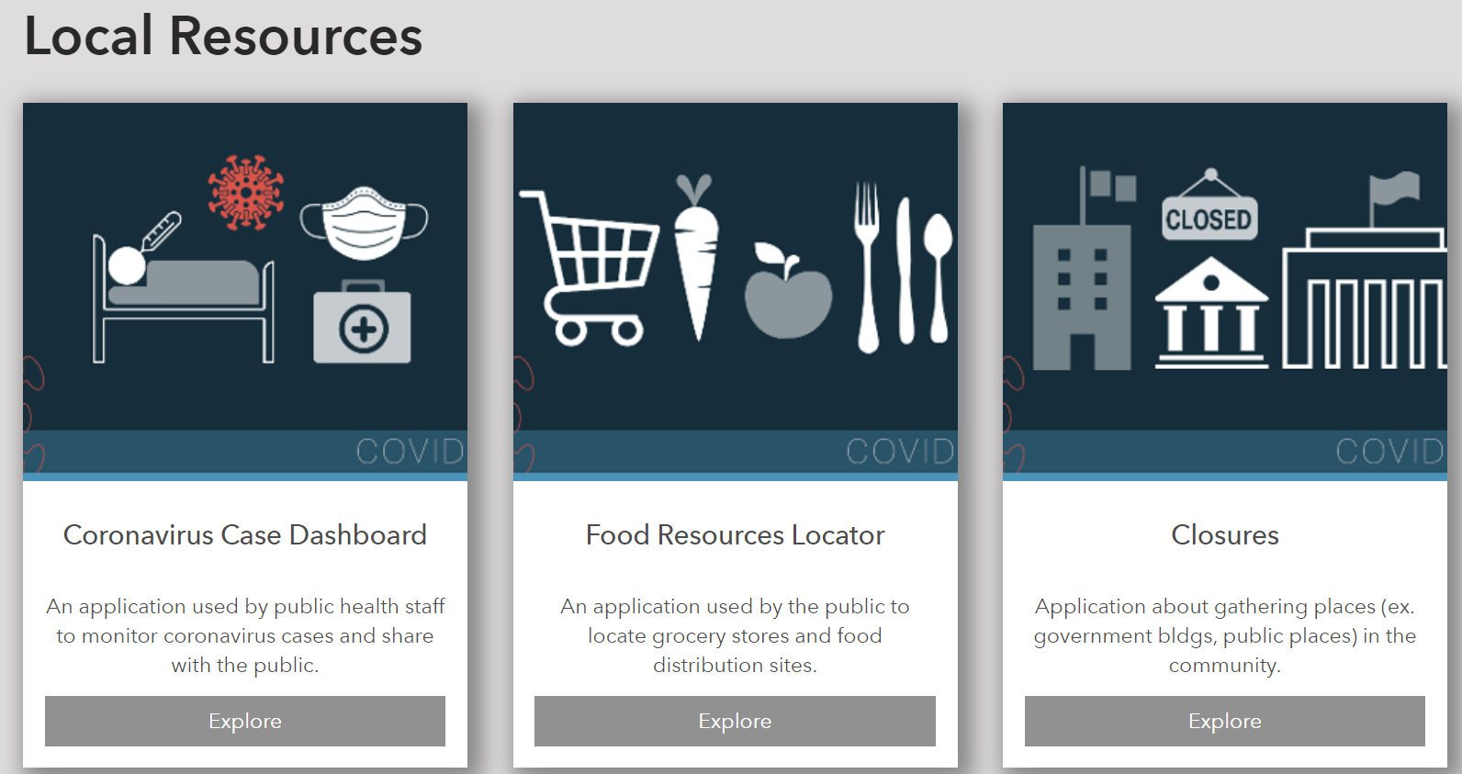
Resource Hub
Click here for Racine County Coronavirus Response Hub

Slide 6
HSD PPE Equipment
Community Partner/Industry Support
8
9
Masks Initiative Sheriff’s Office led masks initiative, receiving 1,200 to date
7
1
Municipalities EOC amassing PPE equipment for municipalities
Personal Protective Equipment
SCJ Support SCJ cleaning packs to
all police and fire
East of I-94
6
2
National
Stockpile
First Delivery First delivery out by Monday, March 23
5
3
PPE Requests Municipalities request PPE at EOClogistics@racinecounty.com
4
Delivery Prioritization EOC prioritizes deliveries, (e.g., long-term care facilities)

Slide 7
Housing
Designated living units for healthy and symptomatic emergency responders-- Vacant nursing homes, hotels, and schools
Designated areas for hospital overflow
Contingency Planning

Slide 8
Voting/Elections
Schedule
Elections will continue as scheduled
Municipalities and Staffing
Working with all municipalities to ensure manpower needs are met. County may deploy staff in needed areas
Guidelines and Best Practices
County Clerk reached out to state for election guidelines and best practices, which were shared with all municipalities
Personal Protective Equipment
PPE for election staffers
Curbside Voting
County Clerk working with municipalities on best procedures for curbside voting

Slide 9
Communication
County-led meeting by phone twice a week
50%
Administrators, Clerks, and
Heads of Government on call
Daily call with Cabinet
Calls are Mondays and Thursdays at 2:30 PM

Slide 10
Enforcement of Governor Evers’ Safer at Home Initiative
Enforcement
The Sheriff’s Office is not randomly looking for violation of initiative
Production
Violations
Will react to clear violations of people in mass

Slide 11
Continuity of Operations Plan (COOP) and Continuity of Government (COG) Municipal Guidance

Slide 12
Racine County First Responder Initiatives
Reduction in acceptance of low level in-custody offenses at the Racine County Jail
Increased utilization of video hearings for certain court proceedings
Dispatch implementing Infectious Disease Protocols
First responder recommendation for use of PPE under certain circumstances

Slide 13
Racine County Jail Initiatives
New screening process
Upgraded cleaning/sanitation schedule
New protocol for individuals suspected of being sick
Expanded isolation areas
Coordination with Medical Staff and Health Department
Change in professional visitor process
Change in inmate visitation process

Slide 14
Pandemic Plan
Alternative work schedules
Modified staffing levels
Telecommuting
Sick employees
Employees with plan for their families

Slide 15
COOP/COG
Mission essential functions
Orders of succession
Delegation of authority
Critical exterior resources and service providers

Slide 16
Essential Service Delivery and Essential Supplies

Slide 17
External
Medication
Food
- Receiving medicine depends on pharmacy and USPS’s ability to deliver
- Contact physician for refills
- Inquire about multiple months’ worth of supplies
Shelf stable foods in reasonable amounts to prepare for quarantine
Congregate meal sites closed Tuesday, March 17
Meals on Wheels moving to shelf-stable meals with six-week supply
Municipality functions such as water and sewer expected to be unaffected; therefore, hoarding of toilet paper and water is deemed unnecessary
- Minimize public transportation
- Contact clinic prior to scheduling/attending doctor’s appointment
- Call ahead for all services and prioritize over-the-phone or remote service
Transportation
Cleanliness
Guidelines are critical for vulnerable adults and homebound (quarantined) residents

Slide 18
Internal
Succession Planning
Contingent Workforce
Identify at least three employees in line of succession
Replace missing essential with existing non-essential staff
Social Distancing
Tele-Commuting
Identify areas within municipalities that can work remotely
Complete transactions over phone or internet
Emergency
Communication
Volunteer Services
Utilize templates to draft emergency procedures for municipalities
Identify areas to utilize volunteers while monitoring high-risk individuals
Alternative Work Schedules
Revoke Time Off
Manage reduced workload by adjusting staff schedules
Revoke vacation and compensatory time off as needed

Slide 19
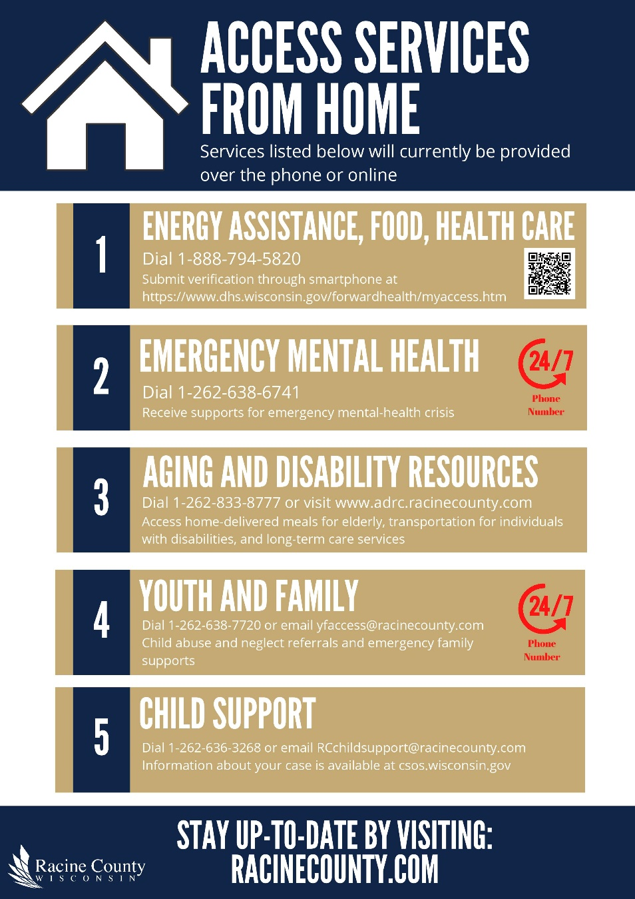
Communicate Remote Access to Emergency Services

Slide 20
Department
Updates

Slide 21
Communications: 911 Emergency Dispatchers
Separate Groups
Separated into two groups: Ives Grove and City of Racine
Contingency Staff
Created bench of retired and former dispatchers
Staffing Rotations
Staffing rotation ready to go in case a large contingent of staff are sick
Staff sit 10 feet apart and wipe down workspace, equipment, and surfaces every four hours. Main and backup centers are professionally disinfected weekly.
Public-Health Protocol

Slide 22
Human Resources
Essential
Non-Essential
Attendance Essential staff continue to report to work except if symptomatic
Attendance Majority of non-essential employees are telecommuting or are assigned to special projects
1
2
Racine County Staff
Assignments Employee lists are being compiled of those non-essential employees who can be reassigned as needed
Recruitment Continues for essential positions only
3
4

Slide 23
Information Technology
Maintaining Connection
Microsoft Skype / Microsoft Teams for instant communication
Capability for audio conferencing (complete) and video conferencing (in progress)
Supporting
Racine County Staff
Ensure Technology Helps, Not Hinders
Purchase laptops to assist in time of need
Ensure all applications and files are employee accessible
Cybersecurity
Critical to remain extra vigilant during times of crisis
General security best practices to be followed when working remotely
Keep data secure through use of County infrastructure
Information Technology Support
Staffing
Limited on-site presence at County facilities for past 2 weeks
As of 3/30/2020, all IT employees are working remotely with rotating “on-call” employees to be on-site at County facilities if needed
Normal business hours with after-hours support
Ongoing municipality support

Slide 24
Public
Separate Groups Two groups in Public Works – E&W Shops. Two groups in
Development Services Offices. Each group rotates through, operating at 50% capacity.
Staffing Rotations Public Works: One week on, one week off with all staff on call for emergencies, accidents, or incidents. PWDs: 3/2 rotations.
Current Workload Public Works: Road work and repairs. PWDs: Processing permits to keep projects moving; drop off box in lobby with staff contact via phone or email; contractors and plumbers happy permits are being processed. Parks and Engineering: Parks open with exception of executive mandated closures.
Works
Public-Health Protocol Staff sanitize offices throughout day, including start and end of shift. Social distancing mandated in office and the field. Public Works trucks are single driver only. Trucks and equipment are sanitized at end of each operational period.

Slide 25
Finance
Essential Functions
Mission essential functions identified and being performed. Payroll and Accounts Payable functions will continue as usual.
01
Purchasing Activity
Purchasing activity elevated due to COVID-19 related procurements. Separate project and accounts created to track for potential reimbursement.
02
Finance Staffing
Majority of Finance staff are telecommuting or rotating/staggering shifts as needed.
03
Wages and Billing
All County non-essential staff, unable to work remotely, are still being fully paid. Non-work time is being tracked using a COVID19 code for potential reimbursement.
04
Print, Mail, and Courier
Print Shop, Mail Room, and Courier services are still operating with modified hours and procedures to limit contact.
05

Slide 26
Bond Issuance
Overview
Bond issuance scheduled for March 26 postponed indefinitely
Postponed
Postponement due to liquidity issues in credit markets
Reason
Continue to work with our bond advisors (PFM;Q+B) to identify opportune time to reschedule the sale
Regularly update finance committee as to current status
Next Steps

Slide 27
Human Services
Fiscal
70% teleworking
Economic Support Services
80% teleworking
15 contract documents completed using Adobe digital signatures
All reporting deadlines were met
100% of invoices were paid timely
2552 applications processed in the last two weeks, up from 2019
Workforce Solutions
70% teleworking
228 visits and 312 calls last week
6897 calls were answered in the last two weeks, down from 2019
Staff is contacting customers on a routine basis to advise on financial support, unemployment and job search
201 veterans were assisted last week
Veterans
100% teleworking
Staff has been assisting with Meal on Wheel deliveries and reception coverage
Notes:
Fiscal
70% teleworking
Two of the clerks cannot work offsite (their jobs are to deposit money, scan, etc and can’t be done from home)
One staff we are working to get a laptop and will hopefully be telework sometime this week
There’s a fiscal manager presence in the building 3 days a week
Fiscal Manager and the two fiscal ops managers are rotating into the office one day a week and the other days working from home
All reporting deadlines were met
15 contract documents completed using Adobe digital signatures
100% of invoices were paid timely
We are working with IT to purchases Adobe Pro for supervisors to create a better digital workflow
Economic Support Services
80% teleworking
6897 calls were answered in the last two weeks
Call volume seems to be down, but since the State extended the month of renewal for thousands of cases, this could be a good explanation of reduced calls. Looks like we may end up this month with about 1,000 less calls than 2019, but we are answering quicker and we are answering near 97% of our calls this year (vs. 93% on 2019)
2552 applications processed in the last two weeks
That is up 289 from 2019 and 532 from 2018
Workforce Solutions
70% teleworking
Staff is contacting customers on a routine basis to advise on financial support, unemployment and job search
Staff has been assisting with Meal on Wheel deliveries and reception coverage
Last week there were 228 visits and 312 calls
Veterans
100% teleworking
201 Veterans were assisted last week

Slide 28
Human Services Cont.
Detention - Population of 28 as of 03.30.20
Behavioral Health Services
Youth & Family – 61 IA reports in the last two weeks, down 35% from February
ACE Coordinators have started 20-minute visitations throughout the day via Skype or Facetime with families of youth in our facility.
Juveniles are allowed free phone calls throughout the day from their approved contact list.
ACE Coordinators set up daily visits with our mental health professional over an app called TEAMS to keep conversations confidential and to provide ongoing services.
95% teleworking
One piece of protective equipment secured for each IA staff
Authorized purchase to hold 4 shelter beds
Phone and virtual interactions when possible
Medication monitoring, lab work, injections are all occurring as normal (face-to-face)
APS is conducting investigations as needed
Virtual visits
Triage general EOC concerns
Triaging youth - Temperature/Questionnaire/Fever Protocol
75% teleworking
Increase in emergency detentions (25%) and SAIL admissions (56%)
Notes:
Detention
Visitation
During this time my ACE coordinators have started (03/23/20) 20 min visitations throughout the day for skype or face time with the families of the kids in our facility. This has been extremely positive as the kids are able to see their rooms, family pets and family. These visits are being supervised by the ACE Staff and confirmed as an appropriate contact.
Currently the Juveniles are allowed free phone call throughout the day from their approved contact list.
Mental Health
Due to being down one mental health professional because of being quarantined. the ACE coordinators set up daily visits with our mental health professional over an app called TEAMS to keep conversations confidential and to provide ongoing services
Triaging Youth - Temperature/Questionnaire/Fever Protocol
Any juvenile being brought into our facility needs to be asked a series of questions related to symptoms and travel. Our medical nurse would also perform an assessment and temperature check. If medical is not present a supervisor would perform a temperature check. Depending on those answers a juvenile maybe taken to the hospital for clearance by the arresting agency before being admitted into our facility.
If the juvenile is cleared by medical to be processed into our facility and has symptoms related to COVID-19. A 14 day quarantine would begin in a dayroom alone with checks for the safety of juvenile. The on-call doctor would be notified and determine if the full 14 days are needed based on daily temperature checks.
Only per the recommendation of the doctor will a juvenile be removed from quarantine.
Temperatures checks are also being performed on all Detention staff prior to shift to prevent spread of any virus. Anyone with symptoms or fever is sent home.
Behavioral Health Services
75% teleworking
Emergency Detentions to WMHI are up 25% in March compared to Feb and SAIL admission is up 56%
Phone and Virtual Interactions
Outpatient clinic appointments are being keep via phone sessions whenever possible.
Mobile response went to 100% over the phone assessments
Protective Placement investigations and reviews are being done via virtual interactions for all 328 people.
Intoxicated Driver Assessments and Driver Safety Plan monitoring have been moved to phone assessment and monitoring wherever possible.
Some limited crisis is face to face if situation cannot be resolved over the phone.
Medication monitoring, lab work, injections are all occurring as normal (Face to Face).
APS is conducting investigations as needed.
Youth & Family
61 IA reports in the last 2 weeks
This is down 35% from February 2020
It is also down 60% from the first half the month (since school let out)
95% of the Youth and Family Division is currently working remotely – with 2 supervisors and manager rotating into the building Monday through Friday.
We should be at 100% of staff working remotely by April 2nd. Will determine at that time, the need for supervisors in the building.
One piece of protective equipment secured for each IA staff – only staff in division seeing clients face-to-face
Authorized purchase to hold 4 shelter beds
In order to eliminate competition for beds with other counties and allow for a brief quarantine for these children prior to placement in foster care
Virtual Visits
Foster Care re-licenses, Kinship approvals and recertifications continue with virtual visits rather than in-person.
Family in-person visitation on hold. All visitation is currently done virtually.
Community Panels – in person panels on hold. All community panels currently done virtually
Youth and Family supervisors/manager triaging general EOC concerns that come in

Slide 29
Impact Partner Survey and Resource Map
Impact Partner Survey
Survey COVID-19 impact on and needs of community partners and their customers in partnership with the City of Racine and United Way of Racine County.
Resource Map
Created 2-1-1 resource map including meals, childcare, medical care, utilities support, and other essential and emergency services.
Visit resource map at the Coronavirus Response Hub at racinecounty.com/coronavirus.
Click here for resource map

Slide 30
Public Health Updates

Slide 31
Public Health Goals/Objectives
Goal:
To prevent and slow the spread of COVID-19 in the community
Objectives:
Conduct rapid and thorough investigation of all suspect, probable and confirmed cases of COVID-19 and contact tracing with isolation and quarantine of those who are symptomatic or exposed. Of note, almost 100% of our resources are being dedicated to this effort.
Support high risk/vulnerable populations by ensuring long term care facilities and health care settings have the necessary PPE and infection control measures in place to care for residents while reducing the spread of illness.
Disseminate public messaging on the importance of public health guidance, including staying home and practicing social distancing, e.g. Safer at Home.

Slide 32
Racine County COVID-19 Investigations as of 3/30/20
 | CRCHD | CoRPHD | TOTAL
Confirmed Cases | 15 | 9 | 24
Negative Cases | 194 | 132 | 326
Pending | 100 | 38 | 138
Contact Investigations | 112 | 68 | 180
Current testing criteria due to limited capacity:
Asymptomatic should not be tested.
Testing not recommended for mild upper respiratory symptoms.
Testing recommended to make a diagnosis to inform clinical management and infection control, e.g. hospitalized patients, congregate settings, health care workers.

Slide 33
Case Counts Disease Incidence
The number of tests kits and testing capacity currently available remains low. This chart shows hospital visits, an indicator of disease in the community.

Slide 34
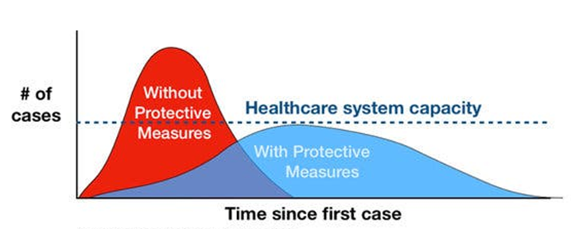
Heed “Safer at Home” Order Slow the Rate of Disease and Flatten the Curve
Maintain Social Distancing
Practice Good Hygiene

Slide 35
Stay Informed
Symptoms: https://www.cdc.gov/coronavirus/2019-ncov/about/symptoms.html
Prevention and Treatment: https://www.cdc.gov/coronavirus/2019-ncov/about/prevention-treatment.html
What to Do if You Feel Ill: https://www.cdc.gov/coronavirus/2019-ncov/about/steps-when-sick.html
Travel Information: https://www.cdc.gov/coronavirus/2019-ncov/travelers/index.html
Avoid social media and other unreliable sources for public-health information

Slide 36
Mental Health & Self-Care
Everyone
Managing Stress/Anxiety
Families and Children
Helping Children Cope with Emergencies
Coping after a Disaster
First Responders
Tips for Taking Care of Yourself
First Responders and Disaster Responders Resource Portal
Resources on Coronavirus Response Hub

Slide 37
Question & Answer
COVID-19
Updates
Discuss
Questions/Concerns

