Slide 1
Respite care training
For Racine County

Slide 2
Respite care training
What is a respite care provider?
Respite care providers for foster families offer short term child care in their home. This gives foster families a break when needed, or helps them out in times of crisis or emergency. Respite care is provided when it works within the respite provider’s schedule.
Respite care helps prevent burn out for foster families and often times respite providers will build relationships with children and foster families and be a consistent respite provider for a child. This helps to create additional positive, adult interactions for children in foster care.

Slide 3
Respite care Training
Who uses respite care?
Foster parents use respite care for children placed in their home. Foster parents can be relatives, too, of the children in their care.
Foster parents can use respite care for emergencies, for self care, to give the child(ren) and caregivers a break, and for scheduling conflicts.

Slide 4
Respite Care Training
How is respite care arranged?
Foster parents can let the foster care workers know when they need respite and respite providers receive a call from the worker to inquire if you are available for respite
Sometimes foster parents can arrange the respite if there is already an established understanding between the foster home, specific respite home, and workers about an ongoing arrangement for respite
There are times of emergency when a county worker may call a respite provider looking for emergency respite and there is very little notice as respite could be needed a soon as possible
There is a rate of 25.00 per day per child for respite care providers

Slide 5
Respite care Training
What information should I have when providing respite care?
Case manager name and contact information
Foster parent name and contact information
Birth parent name and contact information when applicable
Medication needs
Dietary needs
Physical and/or cognitive disabilities
Behavioral and emotional needs of the child to help respite providers care the child (ex: afraid of the dark and needs a night light, tell plans in advance for the day or the child gets anxious)
Foster care unit names and contact information
Dates of care
When applicable: school information, doctor information, visitation information

Slide 6
Respite Care Training
What if there’s an emergency while providing respite care?
Have your emergency contact list ready to go before respite begins
Scenario1: A child you are providing respite care for falls and injures their arm. What do you do?
Scenario 2: A child you are providing respite for is supposed to have medication in the evening from what the foster parent stated, but there are no medications provided when you unpack their things. What do you do?

Slide 7
Respite care training
Child development and the effects of trauma on development
What is child development?
Child development refers to the biological, psychological and emotional changes that occur in human beings between birth and the end of adolescence, as the individual progresses from dependency to increasing autonomy. It is a continuous process with a predictable sequence yet having a unique course for every child-en.wikipedia.org
The early years of a child's life are very important for his or her health and development. Parents, health professionals, educators, and others can work together as partners to help children grow up to reach their full potential.
CDC - Child Development, Home - NCBDDD
www.cdc.gov/ncbddd/childdevelopment/index.html

Slide 8
Respite care training
Child development and the effects of trauma on development
What is trauma?
Typically, complex trauma exposure involves the simultaneous or sequential occurrence of child maltreatment—including psychological maltreatment, neglect, physical and sexual abuse, and domestic violence—that is chronic, begins in early childhood, and occurs within the primary caregiving system-NCTSN
Types of Traumatic Stress | National ... - Child Trauma Home
www.nctsn.org/trauma-types

Slide 9
Respite Care Training
Effects of trauma on emotions, behavior, and learning
Children who have experienced complex trauma often have difficulty identifying, expressing, and managing emotions, and may have limited language for feeling states. They often internalize and/or externalize stress reactions and as a result may experience significant depression, anxiety, or anger.. Their emotional responses may be unpredictable or explosive. A child may react to a reminder of a traumatic event with trembling, anger, sadness, or avoidance. For a child with a complex trauma history, reminders of various traumatic events may be everywhere in the environment. Such a child may react often, react powerfully, and have difficulty calming down when upset. Since the traumas are often of an interpersonal nature, even mildly stressful interactions with others may serve as trauma reminders and trigger intense emotional responses. – NCTSN
A child with a complex trauma history may be easily triggered or “set off” and is more likely to react very intensely. The child may struggle with self-regulation (i.e., knowing how to calm down) and may lack impulse control or the ability to think through consequences before acting. As a result, complexly traumatized children may behave in ways that appear unpredictable, oppositional, volatile, and extreme. A child who feels powerless or who grew up fearing an abusive authority figure may react defensively and aggressively in response to perceived blame or attack, or alternately, may at times be overcontrolled, rigid, and unusually compliant with adults. -NCTSN
Children with complex trauma histories may have problems thinking clearly, reasoning, or problem solving. They may be unable to plan ahead, anticipate the future, and act accordingly. When children grow up under conditions of constant threat, all their internal resources go toward survival. When their bodies and minds have learned to be in chronic stress response mode, they may have trouble thinking a problem through calmly and considering multiple alternatives. They may find it hard to acquire new skills or take in new information. They may struggle with sustaining attention or curiosity or be distracted by reactions to trauma reminders. They may show deficits in language development and abstract reasoning skills. Many children who have experienced complex trauma have learning difficulties that may require support in the academic environment.-NCTSN

Slide 10
Respite Care Training
Are there things I can give the children permission to do? What are things I can’t give permission for children to do?
Respite providers cannot make decisions about a child in their care regarding issues like visits and overnights. This doesn’t come up often, but can at times when children are in respite for a week or more. You should be provided information from workers and foster parents about what is permissible for a child so you feel confident with decision making, but here are couple of scenarios to consider.
Scenario- a respite child in your care for a few weeks wants to spend the night with a friend.
Scenario- a child you see on a regular basis for respite care wants to spend an extra 15 minutes on the phone with their parent.

Slide 11
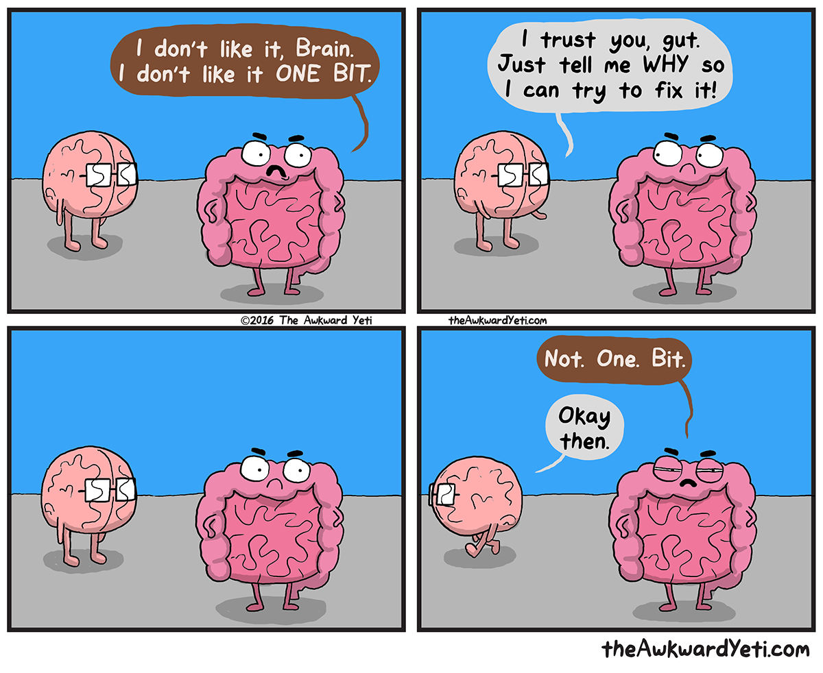
Respite Care Training
To be confident and feel enjoyment as a respite provider it’s important to remember the following:
Communication is key in respite care. It helps all parties involved to be on the same page and support one another. If you have a question or something doesn’t seem okay to you reach out to your contact list to talk it through or look for direction.

Slide 12
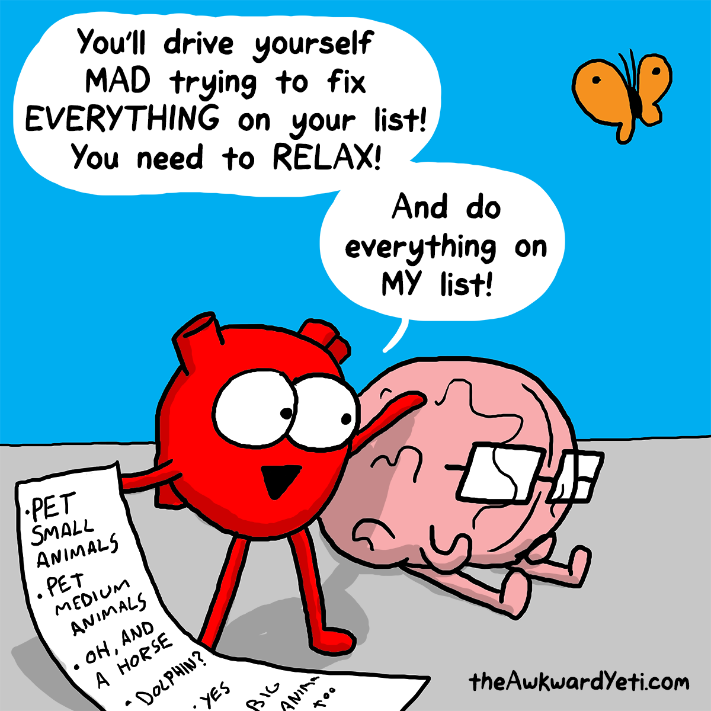
Respite care training
To be confident and feel enjoyment as a respite provider it’s important to remember the following continued..
Don’t forget to take care of yourself
Don’t feel obligated to say yes to providing respite at times when your own life is chaotic, too busy, or simply not a good time to provide respite care.

Slide 13
Thank YOU
Thank you for taking the time to learn about being a respite provider
Questions from the group

